Slide 1

UNIVERSITY INSTITUTE OF ENGINEERING
DEPARTMENT OF AIT - CSE
Bachelor of Engineering (CSE)
Advanced Programming (20CST-337)
By: Rahul Rathore(E12904)
Lecture -6
Binary Exponentiation, Computing greatest common divisor, Linear Diophantine Equations
DISCOVER . LEARN . EMPOWER

Slide 2
Chapter | Course Objectives
1. | This subject aims to focuses on Advanced concept of C++ and advanced data structure to students. It focuses on advanced level analysis of algorithm and computational mathematics.
Chapter | Course Outcomes
1. | Explain the data structure and OOPS concepts using C++. Apply the shortest path and minimum spanning algorithms in computer networks. Examine the complexity of searching and sorting algorithms, and optimization through arrays, linked structures, stacks, queues, trees, and graphs. Decide and implement an appropriate graph algorithm and hashing function in computer networks for data security. Construct security encryption and decryption algorithms using computational mathematics and graph algorithm.

Slide 3
Binary Exponentiation

Slide 4
Binary exponentiation (also known as exponentiation by squaring) is a trick which allows to calculate a^{n} using only O(logn) multiplications (instead of O(n)O(n) multiplications required by the naive approach).
It also has important applications in many tasks unrelated to arithmetic, since it can be used with any operations that have the property of associativity:
(X⋅Y)⋅Z=X⋅(Y⋅Z)(X⋅Y)⋅Z=X⋅(Y⋅Z)
Most obviously this applies to modular multiplication, to multiplication of matrices and to other problems which we will discuss below.

Slide 5


Algorithm
Raising a to the power of n is expressed naively as multiplication by a done n−1n−1 times: an=a⋅…. However, this approach is not practical for large a or n.
The idea of binary exponentiation is, that we split the work using the binary representation of the exponent.
Let's write n in base 2, for example:

Slide 6
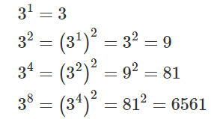
Since the number n has exactly ⌊log2n⌋+1 digits in base 2, we only need to perform O(logn) multiplications, if we know the powers a¹,a²,a⁴,a⁸,…,…,a^{⌊log⁡n⌋}.
So we only need to know a fast way to compute those. Luckily this is very easy, since an element in the sequence is just the square of the previous element.

Slide 7
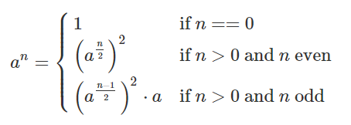
The final complexity of this algorithm is O(logn): we have to compute logn powers of a, and then have to do at most logn multiplications to get the final answer from them.
The following recursive approach expresses the same idea:

Slide 8
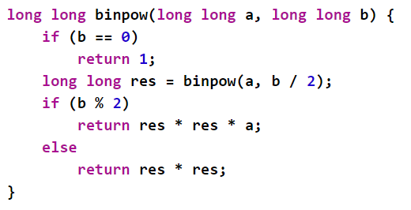
Implementation
Recursive Approach

Slide 9
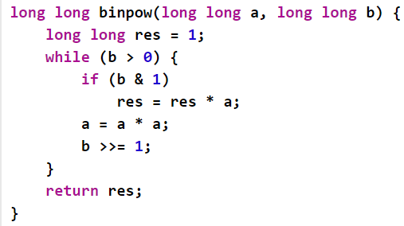
Implementation
Iterative Approach

Slide 10

Euclidean algorithm for computing the greatest common divisor
Given two non-negative integers a and b, we have to find their GCD (greatest common divisor), i.e. the largest number which is a divisor of both a and b. It's commonly denoted by gcd(a,b). Mathematically it is defined as:
When one of the numbers is zero, while the other is non-zero, their greatest common divisor, by definition, is the second number. When both numbers are zero, their greatest common divisor is undefined (it can be any arbitrarily large number), but we can define it to be zero. Which gives us a simple rule: if one of the numbers is zero, the greatest common divisor is the other number.

Slide 11
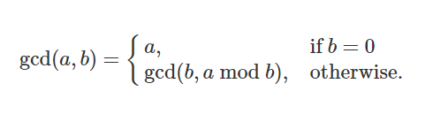
Algorithm
The algorithm is extremely simple:

Slide 12
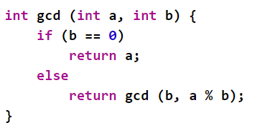
Implementation

Slide 13
Extended Euclidean Algorithm
While the Euclidean algorithm calculates only the greatest common divisor (GCD) of two integers a and b, the extended version also finds a way to represent GCD in terms of a and b, i.e. coefficients x and y for which:
a⋅x+b⋅y=gcd(a,b)
It's important to note, that we can always find such a representation, for instance gcd(55,80)=5 therefore we can represent 55 as a linear combination with the terms 55 and 80: 55⋅3+80⋅(−2)=5

Slide 14
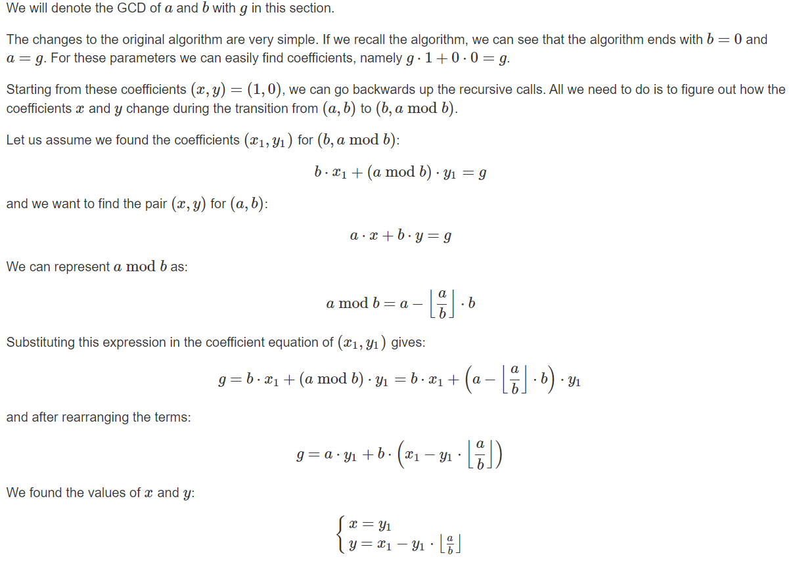
Algorithm

Slide 15
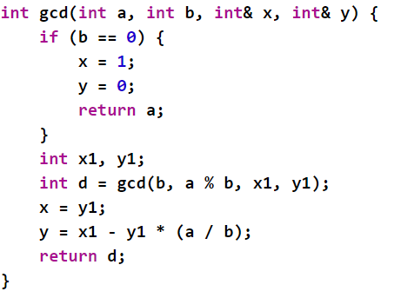
Implementation

Slide 16
Linear Diophantine Equation
A Linear Diophantine Equation (in two variables) is an equation of the general form:
ax+by=c
where a, b, c are given integers, and x, y are unknown integers.
We consider several classical problems on these equations:
finding one solution
finding all solutions
finding the number of solutions and the solutions themselves in a given interval
finding a solution with minimum value of x+y

Slide 17

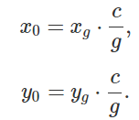
Finding a solution
To find one solution of the Diophantine equation with 2 unknowns, you can use the Extended Euclidean algorithm. First, assume that aa and bb are non-negative. When we apply Extended Euclidean algorithm for aa and bb, we can find their greatest common divisor gg and 2 numbers x_{g} and y_{g} such that:
ax_{g}+by_{g}=g
If c is divisible by g=gcd(a,b), then the given Diophantine equation has a solution, otherwise it does not have any solution. The proof is straight-forward: a linear combination of two numbers is divisible by their common divisor.
Now supposed that c is divisible by g, then we have :
Therefore one of the solutions of the Diophantine equation is:
The above idea still works when a or b or both of them are negative. We only need to change the sign of x0 and y0 when necessary.

Slide 18
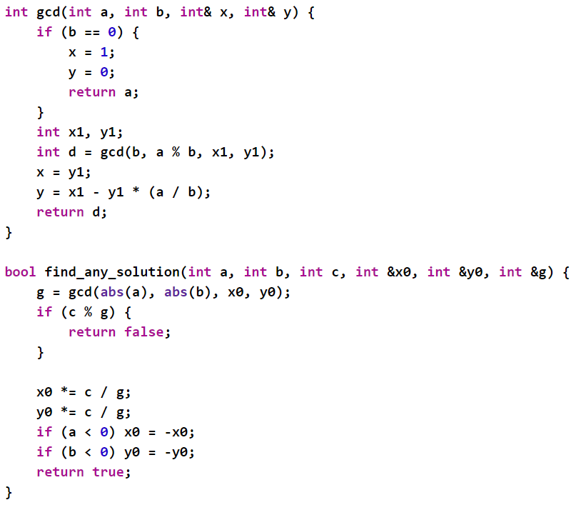
Implementation

Slide 19
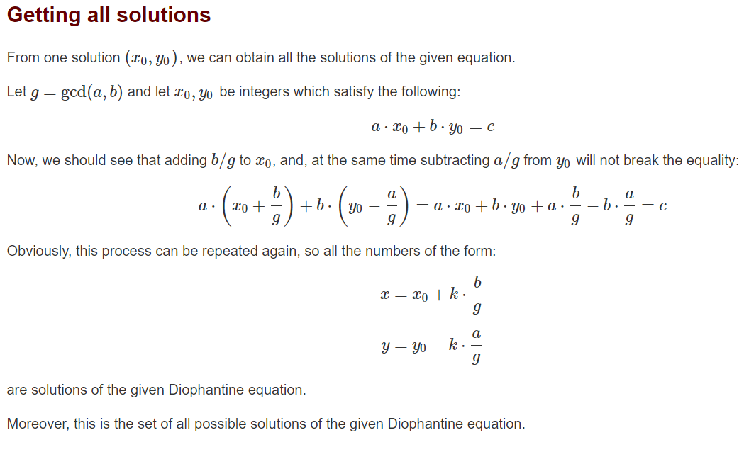

Slide 20
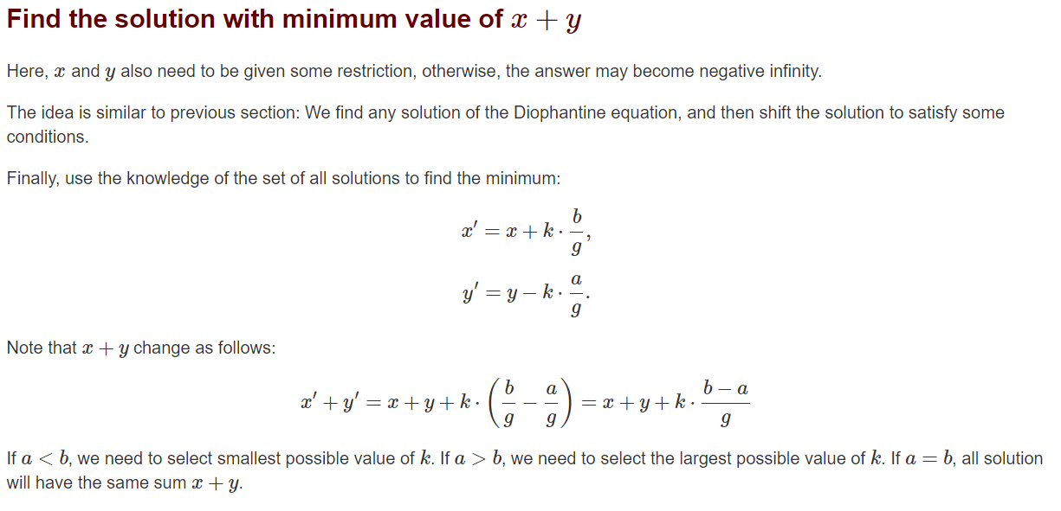

Slide 21
THANK YOU

